Slide 1


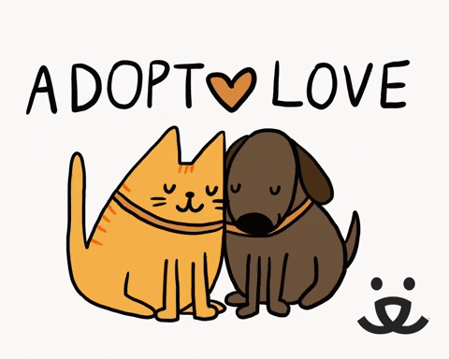
Portage APL
Dashboard
Group 6:
Dutt Thakkar, Madelynn Tomkos,
Shefali Gupta, Tammy Liu

Slide 2
01. Objective
04. Key Results
02. Dashboard
05. Charts & Insights
03. Data Exploration
06. Recommendations

Slide 3

Portage APL
The objective of the Portage Animal Protective League (APL) is to provide a safe and caring environment for abandoned, abused, and neglected animals, and to find them loving, permanent homes. They also aim to promote responsible pet ownership through education and advocacy in the community. Additionally, the organization strives to prevent animal cruelty and to enforce laws that protect animals.

Slide 4
Our Objective
APL Portage is seeking to optimize their animal welfare efforts by leveraging data-driven insights. They plan to analyze their data to identify trends and patterns that can help them allocate resources more efficiently and provide better care for animals in need. For instance, they may compare intake rates across different cities to identify potential areas for improvement. By extracting actionable insights from their data, APL Portage aims to enhance their impact and fulfill their mission to help animals.

Slide 5
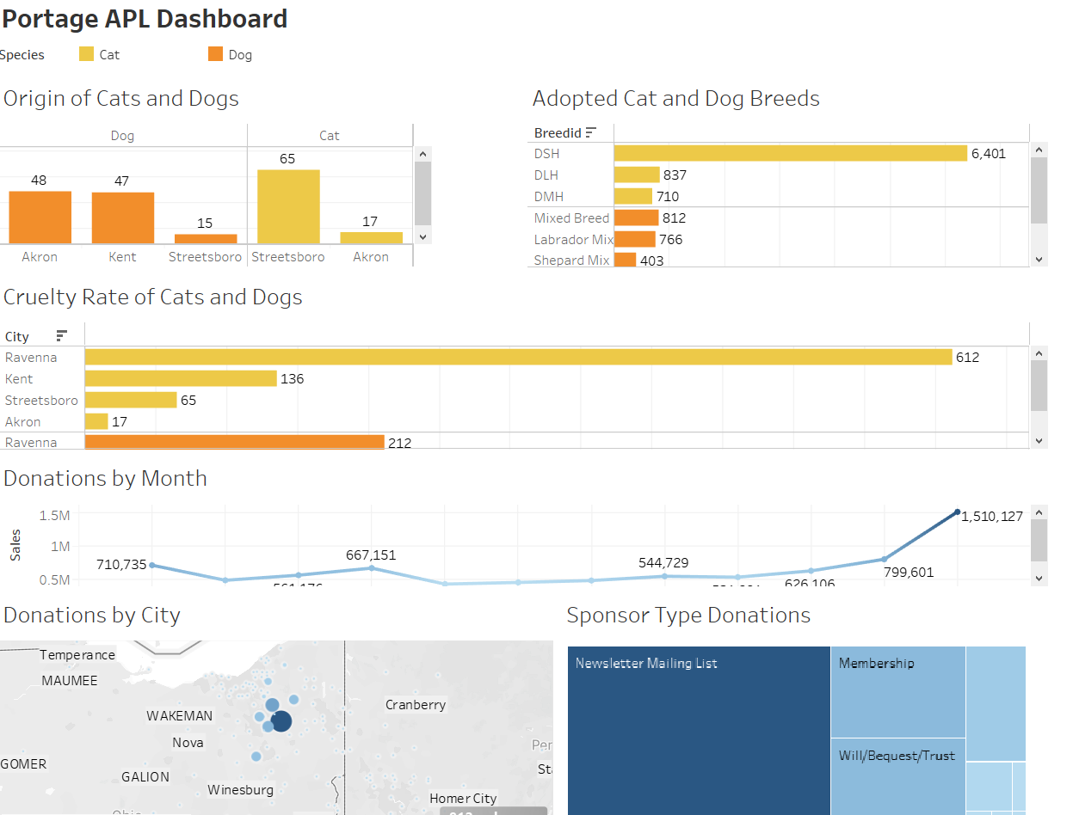
Portage APL
Dashboard
Link to the Dashboard
Click here to view the data file and dashboard -
APL_Dashboad

Slide 6

WHAT WE ARE FOCUSING ON
Tracking adoption rates
Monitoring fundraising efforts
Adoption Trends Over Time
Demographic Analysis of Adopted Animals
Monthly Donation Trends Over Time
Analysis of Sponsorship Revenue Trends by Type
Analyzing intake and surrender data
Spatial Analysis of Reported Cruelty Cases
Intake and Surrender Trends Over Time
Demographic Analysis of Intake and Surrendered Animals
Geographic Trends in Reported Cruelty Cases
Demographic Analysis of Animals Involved in Reported Cruelty Cases

Slide 7
Key Results
Donation trend​
Donation month​
Increasing donation trend across 20 years​
October generates the highest donation​
Donation city​
Cruelty area​
Kent generates the highest donation​
Ravenna shows the highest cruelty rate​
Humane Officer efforts​
Intake ratio​
Streetsboro should be paid more attention ​
Cats have a higher intake ratio than dogs​

Slide 8

Insights
WHAT DID WE
LEARN

Slide 9
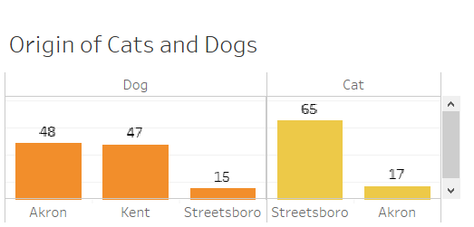
Tracking intake (Cats vs Dogs)
Streetsboro receives the highest number of cats among all the animals that are taken in, whereas dogs are the least frequently taken in animals.
Akron has the highest number of dog intakes compared to other animals, but comparatively few cats are brought in.

Slide 10
Tracking intake (Cats vs Dogs)
Streetsboro receives the highest number of cats among all the animals that are taken in, whereas dogs are the least frequently taken in animals.
Akron has the highest number of dog intakes compared to other animals, but comparatively few cats are brought in.

Slide 11
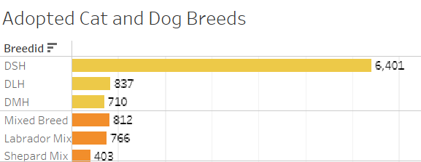
Adoption intake (Top breeds)
The three most common cat breeds seen at APL Portage are Domestic short-hair, Domestic long-hair, and Domestic medium hair.
APL Portage frequently takes in mixed breed, Labrador mix, and Shepard mix dogs, making them the organization's top three most common dog profiles.

Slide 12
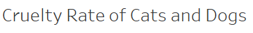
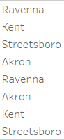
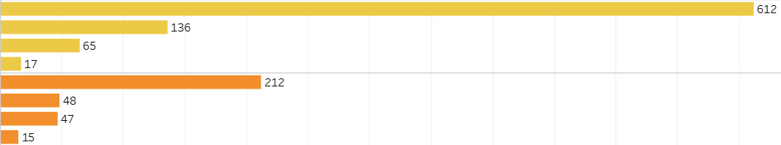
Cruelty Rate (areas)
Ravenna has the highest reported rate of cruelty towards cats among all cities served by APL Portage, with Kent coming in second."
"APL Portage has observed the highest reported rate of cruelty towards dogs in Ravenna, with Akron coming in second place

Slide 13
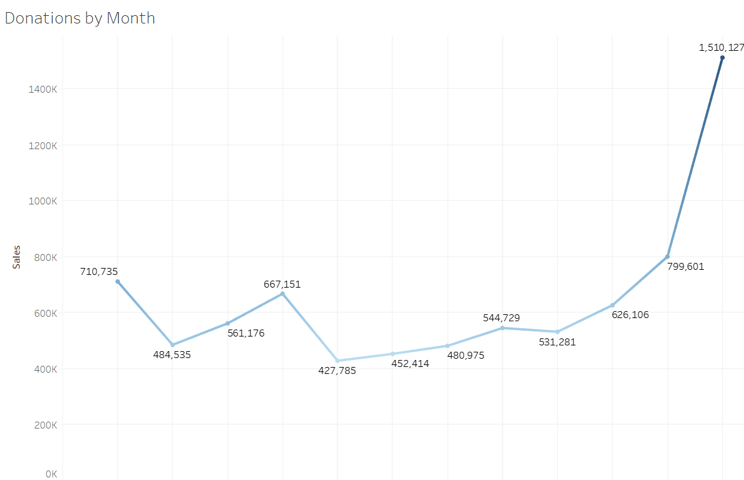
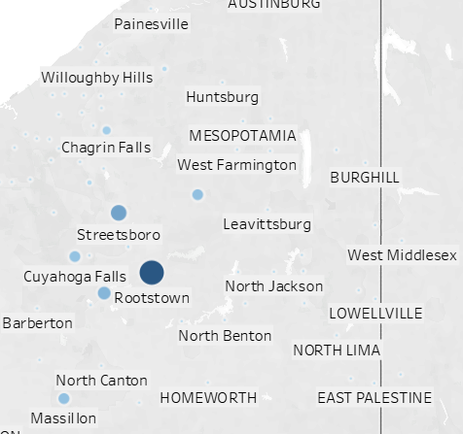
Donation trend (revenue vs area)
We analyzed the average annual donations for 20 years and 5 years.
Kent has donated an average of $119K per year over the past 20 years and $235K per year over the past 5 years.
Ravenna has donated an average of $117K per year over the past 20 years and $148K per year over the past 5 years.
Rootstown has donated an average of $47K per year over the past 20 years and $158K per year over the past 5 years.
Kent has consistently been the leading city in terms of donations over both the past 20 years and the past 5 years.
Rootstown has significantly increased its donations over the past 5 years, showing a generous trend.

Slide 14
Donation trend (across month)
December has the highest donation amounts at APL Portage, followed by November and April.

Slide 15
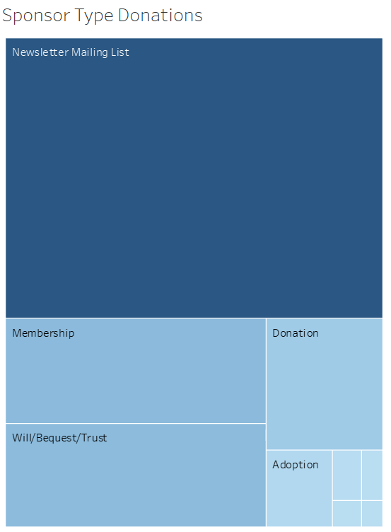
Sponsorship Trends by Type
APL Portage's top five donation types are mailing list, memberships, wills/bequests/trusts, donations, and adoptions.
Over the past 20 years, the mailing list newsletter has been the highest source of funds, generating over three times more funds than the second-highest source.
In the last five years, the mailing list newsletter appeals and membership donations have remained the top two sources of funds.
General donations have replaced wills/bequests/trusts as the third-highest source of funds in the last five years.
The data suggests that APL Portage's donation focus has shifted from wills/bequests/trusts to general donations.

Slide 16

Recommendations
FUTURE
Actionable observatons
Key takeaways and Next Steps……

Slide 17
WHAT CAN BE DONE
Food Inventory Management
Top Profiles for Campaigns
Promotion and Brand Awareness
Use Cats & Dogs Ratio to Manage Food Inventory
Use Top Cat & Dog Profiles for Marketing Campaigns
Focus on High Adoption Areas to Promote APL Brand

Slide 18
WHAT CAN BE DONE
Donation Vs SponsorType
SponsorType Retention
Fundraising Events
Create Specific Campaigns to Increase Focus on Highest yielding SponsorType
Introduce Free Membership Programs to Retain Member Donors
Plan Fundraising Events in December to Attract More Funding

Slide 19
WHAT CAN BE DONE
Human Officer efforts
Fundraising efforts
Ravenna, Kent, and Akron have the highest reported animal cruelty rates hence human officer efforts should be more focused on these areas
Prioritize fundraising efforts in Kent, Ravenna, and Rootstown, which have shown higher average donation amounts over the past 5 years.

Slide 20

Thank You!

